Slide 1
BUILDING A DATA SCIENCE RESUME
HTML
WEEK 7

Slide 2

BUILDING A DATA SCIENCE RESUME

Slide 3
You are going to be creating LIVE resumes for Career Services!
A resumé documents your qualifications and
demonstrates your educational and experiential
skills. It is a marketing tool, designed to get you an interview, that summarizes your qualifications and presents a positive image of you to the reviewer. And it’s LIVE on the interwebs!

Slide 4
RESUME LINK TOOLS
CREDDLE
TABLEAU
CANVA
YOUR OWN WEBSITE
Automatically creates a link just select “publish to unlisted URL”
Link will stay the same with updates, make sure to hit publish on changes
Powerful data visualization you can use to showcase your skills and build resume at the same time
Automatically creates a link
Automatically updates when you make changes
Design your own page to show your abilities
Easiest post-bootcamp

Slide 5
WHAT’S INVOLVED IN BUILDING A RESUME?
KNOW INTERESTS AND SKILLS

Slide 6
WHAT SHOULD A RESUME CONTAIN?
SECTION 1: CONTACT INFO
SECTION 2: PROFILE/SUMMARY
SECTION 3: SKILLS
SECTION 4: PROJECTS
SECTION 5: EDUCATION
SECTION 6 EXPERIENCE
OPTIONAL SECTIONS: AWARDS, ACTIVITIES, VOLUNTEERING, ETC.

Slide 7
CONTACT INFO
NAME
PHONE NUMBER
LINKEDIN
PRO TIPS: USE PROFESSIONAL EMAIL, NO PERSONAL SOCIAL MEDIA (FACEBOOK, INSTAGRAM, ETC), CHECK LINKS, DO NOT ADD FULL STREET ADDRESS HYPERLINK LINKEDIN, EMAIL ADDRESS
EMAIL

Slide 8

SUMMARY

Slide 9
SUMMARY
4 - 5 SENTENCES
DATA EXPERIENCE
BACKGROUND
PASSION
SNAPSHOT OF YOU

Slide 10
QUESTIONS TO ASK YOURSELF:
1: WHAT’S MY SPECIALIZATION?
(DATA MINING, DATABASE DESIGN, ETC.)
2: WHAT DO I HAVE TO OFFER?
(UNIQUE/RELEVANT EXPERIENCE)
3: WHY AM I INTERESTED IN THIS INDUSTRY?
(PASSION, INTEREST, RESEARCH)

Slide 11
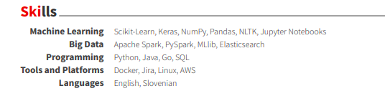
SKILLS
INCLUDE ALL TECHNICAL SKILLS AS WELL AS OTHER SKILLS (MACHINE LEARNING, BIG DATA, PROGRAMMING, PLATFORMS, LANGUAGES) *MAKE SURE TO INCLUDE EVERYTHING*

Slide 12
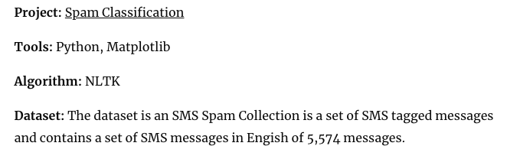
PROJECTS
HYPERLINKED, INCLUDE SHORT SUMMARY (1-2 SENTENCES), DATES, AND TOOLS, ALGORITHMS, DATASET

Slide 13
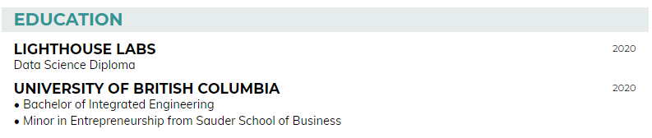
EDUCATION
NAME OF SCHOOL, TITLE OF CREDENTIAL, AND YEAR OF GRADUATION
*INCLUDES CERTIFICATIONS, RELEVANT COURSES, SELF-DIRECTED LEARNING

Slide 14
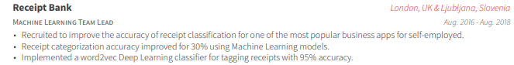
EXPERIENCE
NAME OF ORGANIZATION, JOB TITLE, DATES, TRANSFERABLE SKILLS (APPROX. 3-5 BULLETS)
* INCLUDES EMPLOYMENT, INTERNSHIPS, UNPAID POSITIONS, LEADERSHIP POSITIONS, ETC.

Slide 15
ACTION VERB
SKILL
TASK
WRITING BULLETS
HTML
COLLABORATE
WITH MANAGEMENT AND USERS TO DEVELOP E-COMMERCE STRATEGIES
TO INCREASE TRAFFIC BY ~20%.

Slide 16
ACTION VERB
PROJECT
RESULT
WRITING BULLETS
HTML
SPEARHEADED
MAJOR CHANGE IN USE OF DATA ANALYSIS IN MARKETING DEPARTMENT
INCREASING LEAD GENERATION BY 60% IN A 6 MONTH PERIOD

Slide 17
ADDITIONAL SECTIONS (OPTIONAL)
HACKATHONS/MEET-UPS
PUBLICATIONS
HONORS/AWARDS
PRESENTATIONS
KAGGLE EVENTS
VOLUNTEERING

Slide 18
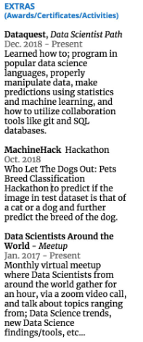
ADDITIONAL SECTIONS (OPTIONAL)

Slide 19

QUICK BREAK

Slide 20
WHAT’S INVOLVED IN BUILDING A RESUME?
KNOW INTERESTS AND SKILLS
KNOW ROLE DUTIES AND QUALIFICATIONS

Slide 21
KNOW ROLE DUTIES & QUALIFICATIONS
JOB POSTINGS
LINKEDIN
MENTORS
COMPANY WEBSITES
ASK US!

Slide 22
WHAT’S INVOLVED IN BUILDING A RESUME?
MATCH INTERESTS AND SKILLS TO ROLES AND DUTIES
KNOW INTERESTS AND SKILLS
KNOW ROLE DUTIES AND QUALIFICATIONS

Slide 23
HOW TO MATCH YOU & THE JOB
RESUME
LHL TECH SKILLS SOFT SKILLS
PAST EXPERIENCES
PASSIONS
DATA NEEDS (ML, Programming, Data Vis, etc) INDUSTRY NEEDS CULTURE/FIT
Pandas SQL
Fintech Problem Solving
YOU
JOB

Slide 24
WHAT’S INVOLVED IN BUILDING A RESUME?
THINK POSITIVELY ABOUT WHAT YOU HAVE TO OFFER
MATCH INTERESTS AND SKILLS TO ROLES AND DUTIES
KNOW INTERESTS AND SKILLS
KNOW ROLE DUTIES AND QUALIFICATIONS

Slide 25
NEGATIVE
REFRAME
POSITIVE
THINKING POSITIVELY
HTML
NO INDUSTRY EXPERIENCE
UNIQUE TRAITS
USE YOUR STORY
MY PROJECTS AREN’T PERFECT
WHAT DOES THE PROJECT SHOWCASE?
SHOWS RESULTS, HARD + SOFT SKILLS
MY SKILLS AREN’T STRONG ENOUGH
WHAT DO EMPLOYERS EXPECT?
PASSION + INNOVATION ARE KEYS TO SUCCESS

Slide 26

ACTIVITY - RESUME CRITIQUE
Notes:
Other good examples here: https://www.beamjobs.com/resumes/data-science-resume-example-guide https://www.dataquest.io/blog/how-data-science-resume-cv/

Slide 27
LINKEDIN
BUILD A NETWORK
SEND MESSAGES
YOUR RESUME +
RECOMMEND & ENDORSE
SHOW YOUR PROJECTS
Add LHL mentors, staff, fellow students, etc.
Send messages, make connections, request information interviews
No page limit, master resume, keep updated
Use “projects” section to showcase your work
Request and write recommendations, endorse each other

Slide 28

COVER LETTERS

Slide 29
Cover letters are one-page documents written as part of the job/internship search that accompany an application to help explain to an employer why you are a strong candidate for a particular position.

Slide 30
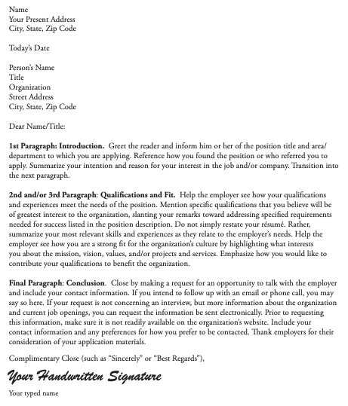
COVER LETTER FORMAT

Slide 31
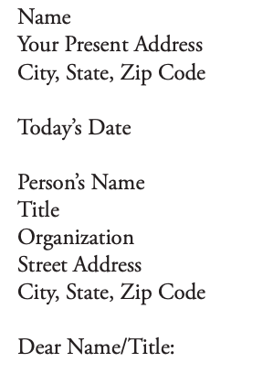
HEADER & GREETING
PRO TIPS: MAKE SURE TO DOUBLE CHECK EMPLOYER INFO, IF YOU DO NOT KNOW WHO TO ADDRESS, USE “DEAR HIRING MANAGER” OR “DEAR SEARCH COMMITTEE”

Slide 32
OPENING
BODY
CLOSING
PARAGRAPHS
+
+
HTML
NAME AND BACKGROUND
POSITION TO WHICH YOU’RE APPLYING
HOW YOU FOUND POSITION OR WHO REFERRED YOU
REASON FOR INTEREST
TRANSITION SENTENCE
REFERENCE JOB DUTIES, RESPONSIBILITIES, QUALIFICATIONS
MATCH THEM WITH YOUR OWN SKILLS AND EXPERIENCE
SPEAK TO COMPANY MISSION, GOALS, VALUES
CONVEY PASSION FOR SPECIFICS ABOUT SAID COMPANY
REFERENCE ATTACHED APPLICATION MATERIALS
INCLUDE CONTACT INFO (PHONE & EMAIL)
INVITE THEM TO CONTACT YOU WITH QUESTIONS
THANK THEM FOR THEIR TIME
ADD SIGNATURE

Slide 33

SEE YOU NEXT TIME

